Slide 2
A Neutral Sampling Effect
Degraded Community
Pristine Community
Small Effect
Large effect
10
Species Richness
8
6
4
2
0
0 30 60 90 120 150 180
Area Sampled
Chase and Knight 2013 Ecology Letters

Slide 3
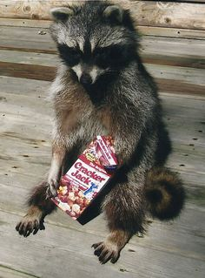

Slide 4
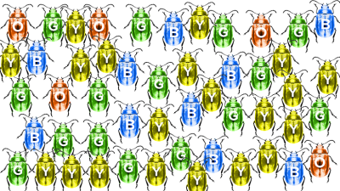
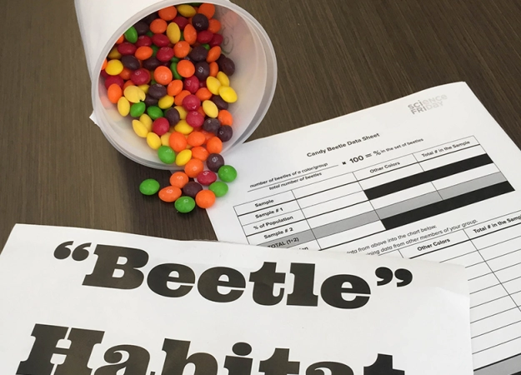

Slide 5
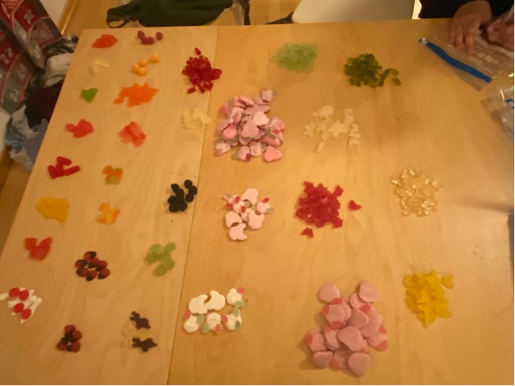

Slide 6
